Slide 1
Browser Exploitation
Jameel Nabbo
Bufferoverflows.net
SEC-T Stockholm 2019

Slide 2
Browser exploitation generic
Techniques used in the exploit kits
UAF exploitation over the years
Java drive exploits
Web app in asm
Web assembly
Delivery techniques

Slide 3
Why it’s interesting
Everyone is using a web browser
No much user interaction is needed
Used for targeted attacks
SEC-T Stockholm 2019

Slide 4
DOM tree exploitation is *******
XSS
CSRF
CORS
Content injection
HTML injection
Second order code injection
SEC-T Stockholm 2019

Slide 5
DOM tree exploitation is ******
XSS
CSRF
CORS
Content injection
HTML injection
Second order code injection
SEC-T Stockholm 2019

Slide 6
Exploiting the web browser
Browser
WASM
Old fashioned
Browser engine
JS CORE
Unknown
SEC-T Stockholm 2019

Slide 7
The old fashioned of browser exploitation
JAVA drive-by
Adobe Flash
Microsoft Silverlight
ActiveX add-ons for web browsers (Mainly internet explorer)
SEC-T Stockholm 2019

Slide 8
Exploit Kits
Blackhole
Phoenix
MPack
Crimepack
RIG
Angler
Nuclear
Neutrino
Magnitude
SEC-T Stockholm 2019

Slide 9
King of exploit kits
SEC-T Stockholm 2019

Slide 10
Blackhole & Angler
Blackhole ended in 2013
Angler is born
Angler used vulnerabilities in Internet Explorer, Silverlight, Flash Player, Adobe Reader, Java, Internet Explorer, and Flash
SEC-T Stockholm 2019

Slide 11
Enumeration techniques used in Angler on IE 8 & 9 & 10
Exploit Microsoft XMLDOM in IE
CVE-2013-7331/ MS14-052
Get internal file system structure
Generate the payload
SEC-T Stockholm 2019

Slide 12
MS14-052
XMLDOM
Angler exploit kit
SEC-T Stockholm 2019

Slide 13
Pre-exploitation phase in MS14-052
Detect if this PC belongs to an analyst
The first attack is used for
targeting the French Aerospace Association
SEC-T Stockholm 2019

Slide 15
Used to Detect Kaspersky – EMET - TrendMicro
SEC-T Stockholm 2019

Slide 16
If (Browser ==
)
||
||
||
||
UAF
SEC-T Stockholm 2019

Slide 17
UAF “Use After Free” Exploitation
Use-After-Free vulnerabilities are a type of memory corruption flaw that can be leveraged by hackers to execute arbitrary code.
UAF occurs:
A memory area is allocated and a pointer points to it.
The memory area is freed but the pointer is still available.
The pointer is used and accesses the memory area previously freed.
SEC-T Stockholm 2019

Slide 18
UAF to code execution
Program allocates and then later frees memory block A.
Attacker allocates a memory block B, reusing the memory previously allocated to block A.
Attacker writes data into block B.
Program uses freed block A, accessing the data the attacker left there.
SEC-T Stockholm 2019

Slide 19
UAF Example
Dangling pointer
SEC-T Stockholm 2019

Slide 20
4 years of happy UAF in Firefox , SeaMonkey
If date >= 2007 && date <= 2011
{
Use-after-free, 'OnChannelRedirect’ // CVE-2008-3835 - CVE-2011-0065
heapspray with a minimal ROP chain to bypass DEP
}
SEC-T Stockholm 2019

Slide 21
Vanilla heap Spray in Firefox, SeaMonkey
Init Fake Vtable
Fill the heap block
Nops + Shellcode
BSTR / DWORD
Have fun ☺
SEC-T Stockholm 2019

Slide 22
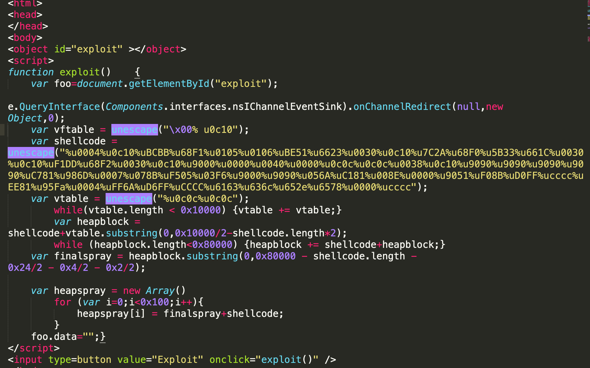
CVE-2011-0065
SEC-T Stockholm 2019

Slide 23
Snowman & Deputydog Operations
SEC-T Stockholm 2019
https://www.zdnet.com/article/new-internet-explorer-10-zero-day-exploit-targets-u-s-military/

Slide 24
Snowman & deputydog Operations Targets
U.S. government entities
Japanese firms
Defense industrial base (DIB) companies
Law firms
Information technology (IT) companies
Mining companies
Non-governmental organizations (NGOs)
SEC-T Stockholm 2019

Slide 25
The delivery technique of CVE-2014-0322
SEC-T Stockholm 2019

Slide 26
Tope.SWF that leads to a second stage dropper called "Erido.jpg"
SEC-T Stockholm 2019

Slide 27
UAF Adobe Flash CVE-2015-5119
SEC-T Stockholm 2019

Slide 28
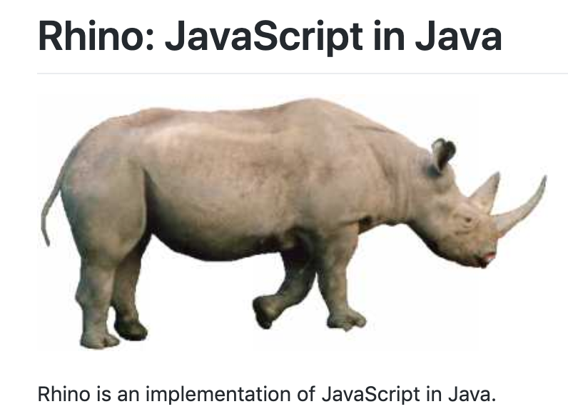
Silent Java-drive by – Rhino engine Exploiting IE, Firefox, Google Chrome (All systems)
Rhino is a JavaScript engine written fully in Java and managed by the Mozilla Foundation as open source software.
SEC-T Stockholm 2019

Slide 29
Some popular java CVEs
CVE-2011-0802
CVE-2011-0814
CVE-2011-0862
CVE-2011-0863
CVE-2011-0865
CVE-2011-3544
CVE-2011-0867
CVE-2011-0868
CVE-2011-0869
CVE-2011-0871
CVE-2011-0873
CVE-2011-3389
CVE-2011-3516
CVE-2011-3521
CVE-2011-3544
CVE-2011-3545
CVE-2011-3546
CVE-2011-3547
CVE-2011-3548
CVE-2011-3549
CVE-2011-3550
CVE-2011-3551
CVE-2011-3552
CVE-2011-3553
CVE-2011-3554
CVE-2011-3556
CVE-2011-3557
CVE-2011-3560
CVE-2011-3561
CVE-2011-3563
CVE-2011-5035
CVE-2012-0497
CVE-2012-0498
CVE-2012-0499
CVE-2012-0500
CVE-2012-0501
CVE-2012-0502
CVE-2012-0503
CVE-2012-0505
CVE-2012-0506
CVE-2012-0507
CVE-2012-0547
CVE-2012-0551
CVE-2012-1531
CVE-2012-1532
CVE-2012-1533
CVE-2012-1541
CVE-2012-1682
CVE-2012-1713
CVE-2012-1716
CVE-2012-1717
CVE-2012-1718
CVE-2012-1719
SEC-T Stockholm 2019

Slide 30
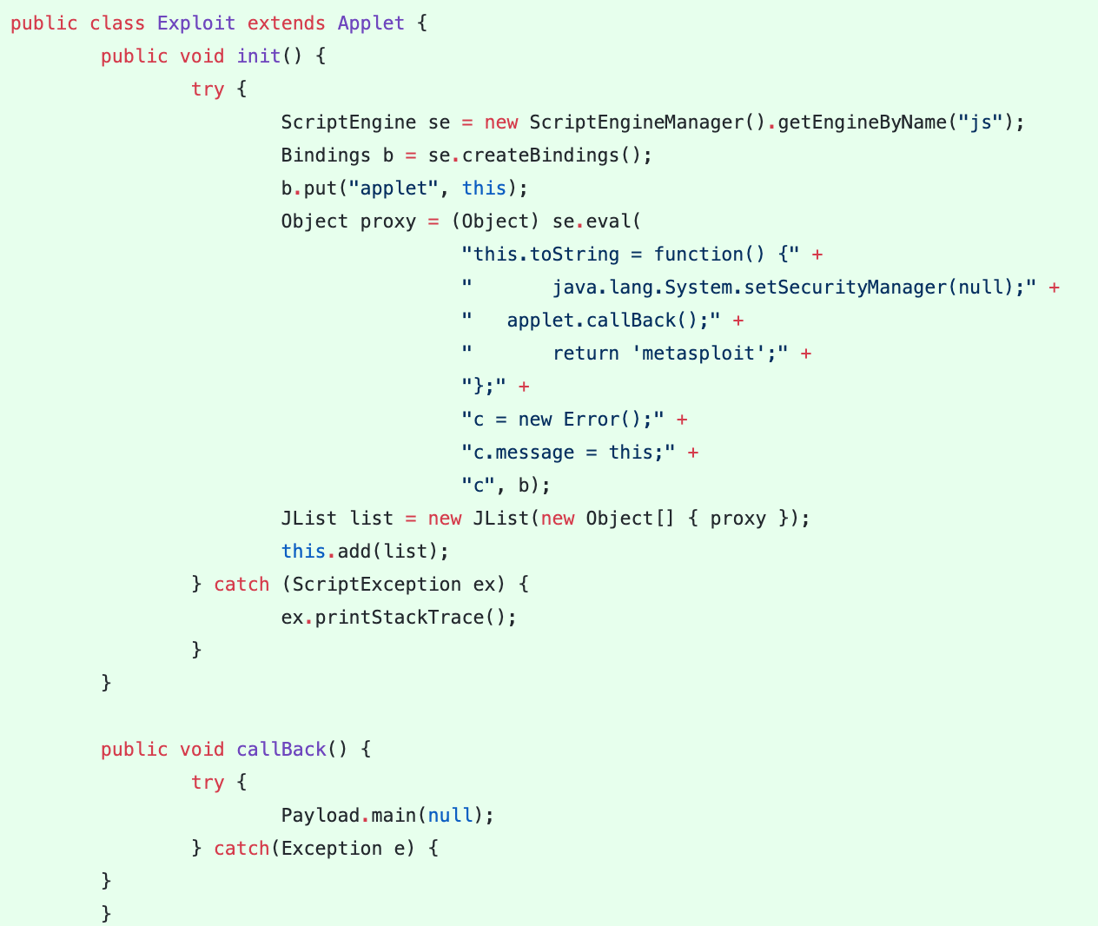
Exploiting Rhino Scripting Engine

Slide 31
Rhino scripting engine NativeError class
On the other hand, when you build such an error object and try to call it from outside the script,
you'll see a surprise:
Exploit steps:
Assign a toString() method to this that will disable the security manager and then run the payload
Create a new JavaScript error object
Overwrite the error object's message property by this
Return the error object
Execution steps:
Create a new script engine and bind the applet to a JS variable
Add the resulting object to a JList
Display the JList to the user and wait for the UI thread to render it

Slide 32
Pure ASM web app
Rendering a web page with a simple request handling method using assembly (Native code)

Slide 33
Web Assembly
Asm.js

Slide 34
Why WASM is there while we have JS already?
WASM is a compiler target
Faster than JS code, because WASM is native code, while JS code needs to be parsed first
WASM allows us to execute C/C++ code on the browser with a performance close to native
WASM wasn't made to be a substitute for JS but to work alongside with it
WASM is often used for developing web games
Speed, Portability, Flexibility

Slide 35
JS VS WASM
https://blog.logrocket.com/webassembly-how-and-why-559b7f96cd71/

Slide 36
WASM supports
Browsers that support WebAssembly

Slide 37
The funny part

Slide 38
ASM and WASM format

Slide 39
WASM binary blobs structure
Section | Code | Description
Type | 1 | Contains a list of function signatures used by functions defined and called by the module. Each signature has an index, and can be used by multiple functions by specifying that index.
Imports | 2 | Contains the names and types of objects to be imported.
Functions | 3 | The declarations (including the index of a signature specified in the Type Section) of the functions defined in this module.
Table | 4 | Contains details about function tables
Memory | 5 | Contains details about memory
Global | 6 | Global declarations
Exports | 7 | Contains the names and types of objects and functions that will be exported.
Start | 8 | Specifies a function that will be called on Module start-up
Elements | 9 | Table initialization information
Code | 10 | The WebAssembly instructions that make up the body of each function.
Data | 11 | Memory initialization information
Custom Section ☺

Slide 40
WebAssembly Modules
WASM Bin
ArrayBuffer
loaded into a WebAssembly Module
WASM Module
module is created
initialization information specified by the bytes in binary format
Parse the Bin
Load needed info
translates the WebAssembly instructions
intermediate bytecode
Execute
Verification of the WebAssembly instructions

Slide 41
Security issues in WASM
Parsing
Loading WASM module
Translates the WebAssembly instructions
Intermediate bytecode

Slide 42
WASM Example in RUST
Rust is a multi-paradigm system programming language focused on safety, especially safe concurrency. Rust is syntactically similar to C++, but is designed to provide better memory safety while maintaining high performance.
curl https://sh.rustup.rs -sSf | sh // brew install rust

Slide 43
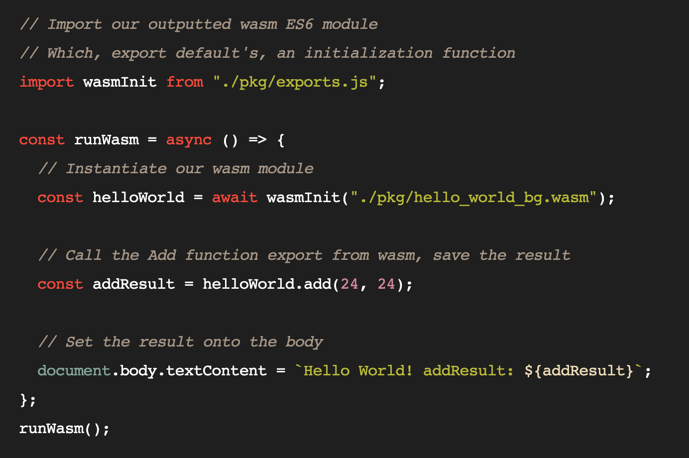
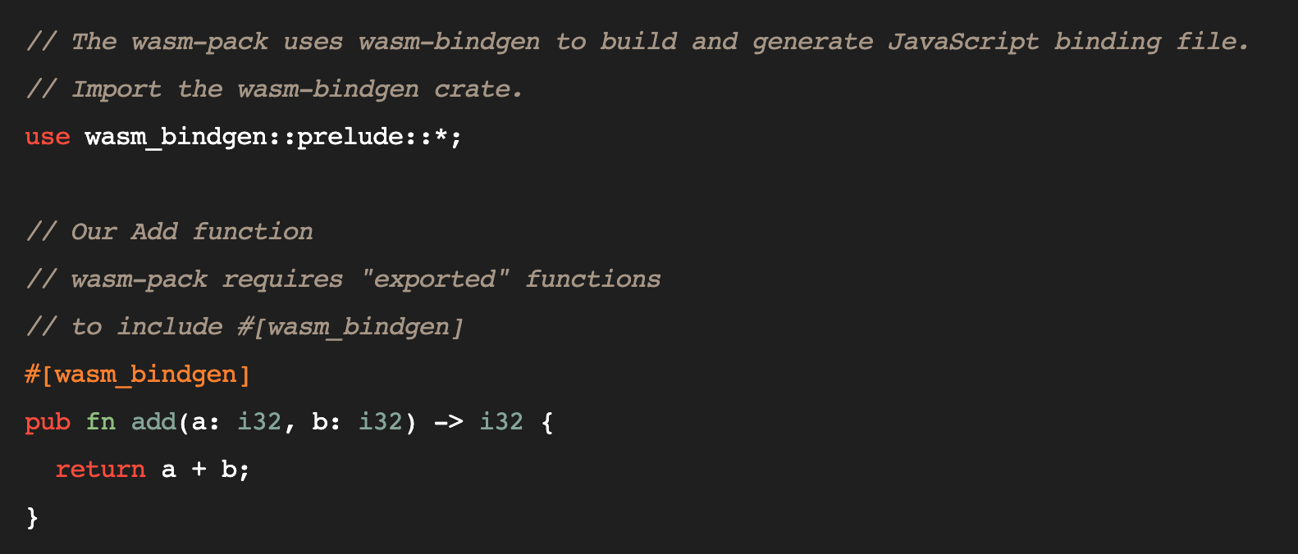
Building Wasm app using rust
cargo install wasm-pack // cargo init
wasm-pack build --target web
All what you need: wasmbyexample.dev

Slide 44
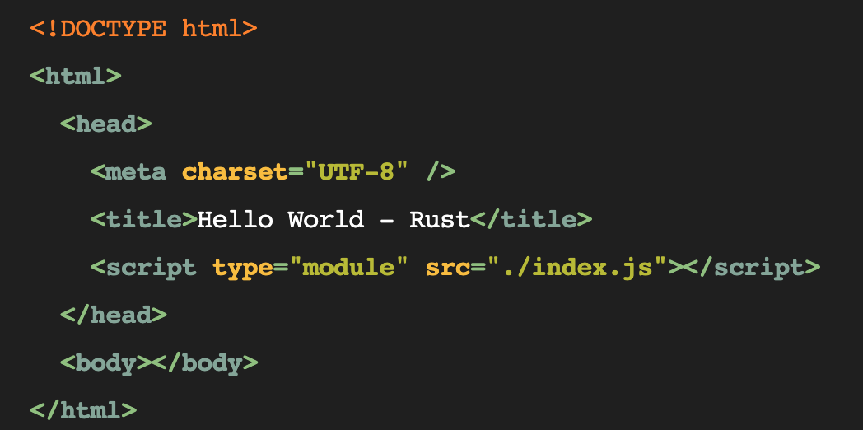
Wasm Page
Index.js
Index.html

Slide 45
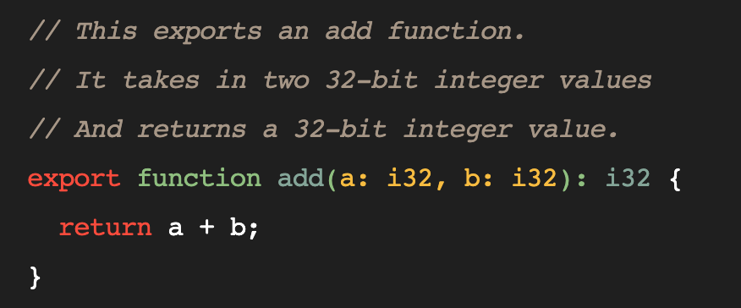
WASM using assembly script typescript-like (Common in the exploitation)
hello-world.ts
asc hello-world.ts -b hello-world.wasm

Slide 46
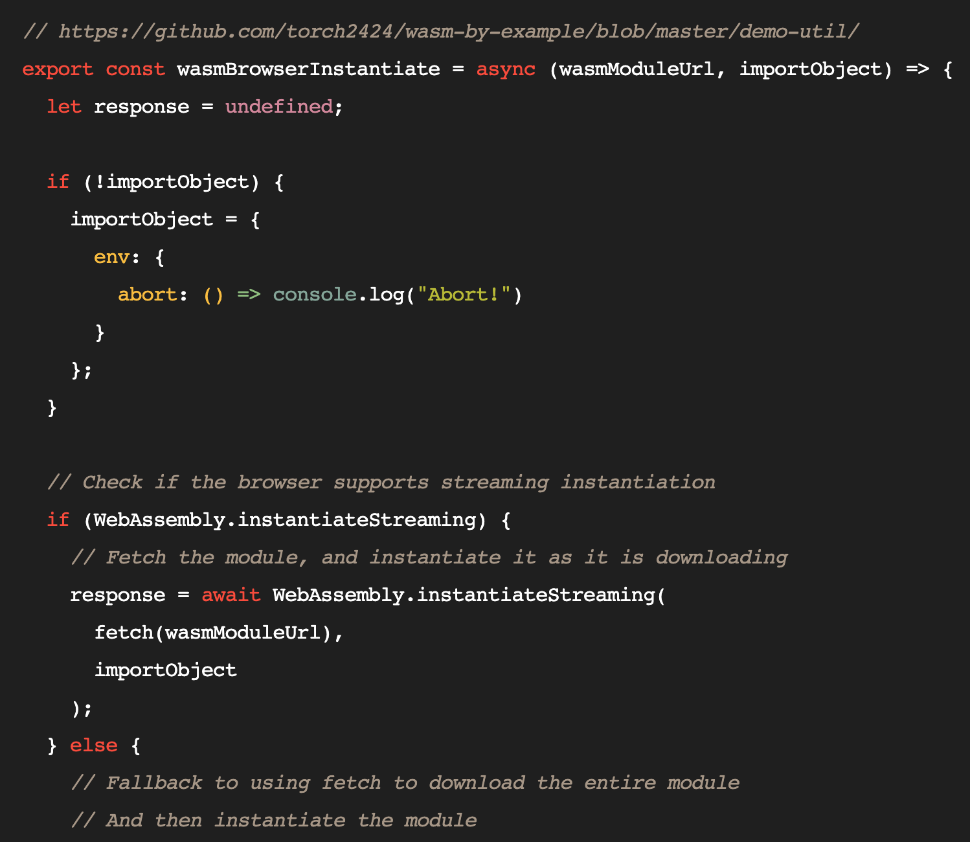
hello-world.js
loading Wasm modules

Slide 47
WebAssembly.instantiateStreaming()
Executing it on the fly ☺

Slide 48
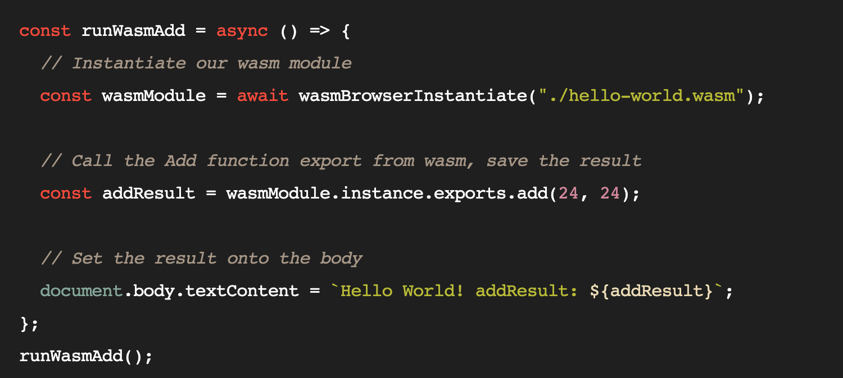
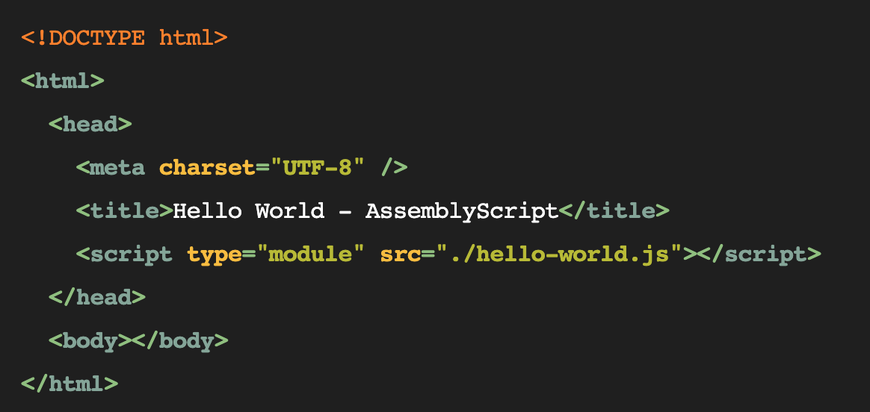
Hello-world.js
Index.html

Slide 49
WASM parser exploitation

Slide 50
WebAssembly source buffers in WebKit / out-of-bounds read
COMPILING THE SOURCE BUFFER
FUNCTION getWasmBufferFromValue
Returns the code buffer
Return arrayBufferView ? static_cast<uint8_t*>(arrayBufferView->vector()) : static_cast<uint8_t*>(arrayBuffer->impl()->data());
If the source buffer is a view (DataView or TypedArray), arrayBufferView->vector() is returned. The vector() method returns the start of the data in the buffer, including any offset.
However, the function createSourceBufferFromValue copies the output of this function as follows: memcpy(result.data(), data + byteOffset, byteSize);
This means that if the buffer is a view, the offset is added to the buffer twice before this is copied. This could allow memory off the heap
to be read out of the source buffer, either though parsing exceptions or data sections when they are copied

Slide 51
memcpy(result.data(), data + byteOffset, byteSize);
memcpy

Slide 52
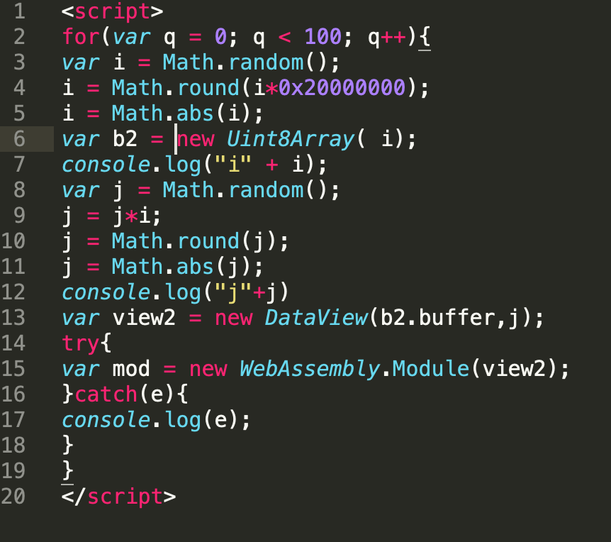
Example CVE-2018-4222 POC

Slide 53
(Type confusion / BOF)
If the previous section was a custom section, the check always returns true, even if the section is
otherwise out of order. This means any number of sections can be parsed from a binary,
any number of times in any order

Slide 54
Exploiting Chrome UAF using WASM functions
FileReader
var importObject = {
imports: { imported_func: arg => console.log(arg) }
};
bc = [0x0, 0x61, 0x73, 0x6d, 0x1, 0x0, 0x0, 0x0, 0x1,
wasm_code = new Uint8Array(bc);
wasm_mod = new WebAssembly.Instance(new WebAssembly.Module(wasm_code), importObject);
return wasm_mod.exports.exported_func;

Slide 55
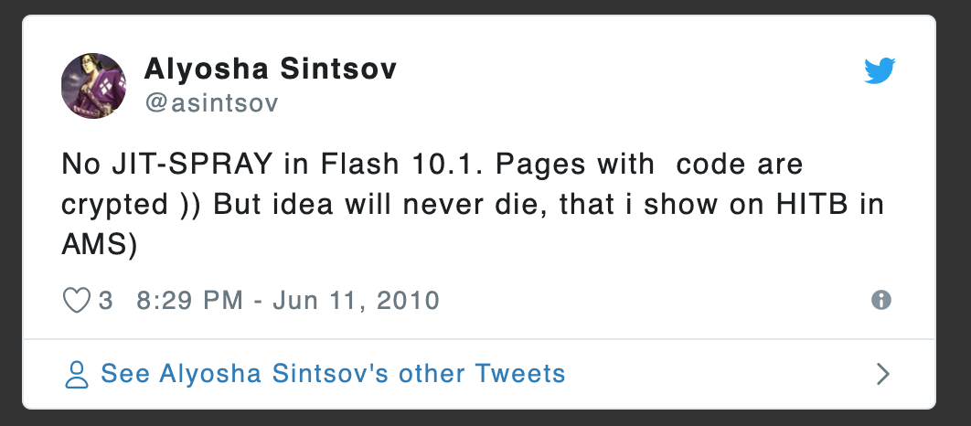
ASM JS & JIT Spray “Love Story”
If exploit == JIT spray {
Browser == “FireFox”;
}
https://rh0dev.github.io/blog/2017/the-return-of-the-jit/

Slide 56
Techniques for delivering the browser exploits High profile individuals
Enumerating their system and mail client by sending an empty email with 1PX image.
When the image is requested on the server side, it will store the request data (Versions, sys info etc.)
Click here to view in the browser ʘ‿ʘ

Slide 57
Email delivery using Iframes
Loading Iframes is supported by default in the email clients for the following:
Windows Mail
Apple Mail 3 / 4
Thunderbird
Android (default client)
iPhone / iPad

Slide 58
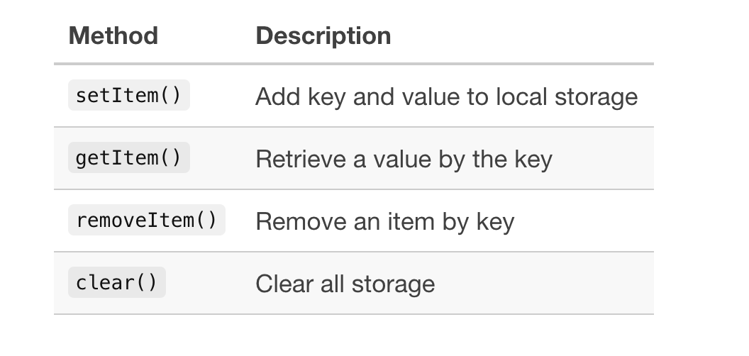
Browser local storage (Black Hole)

Slide 59
My research in 2018

Slide 60
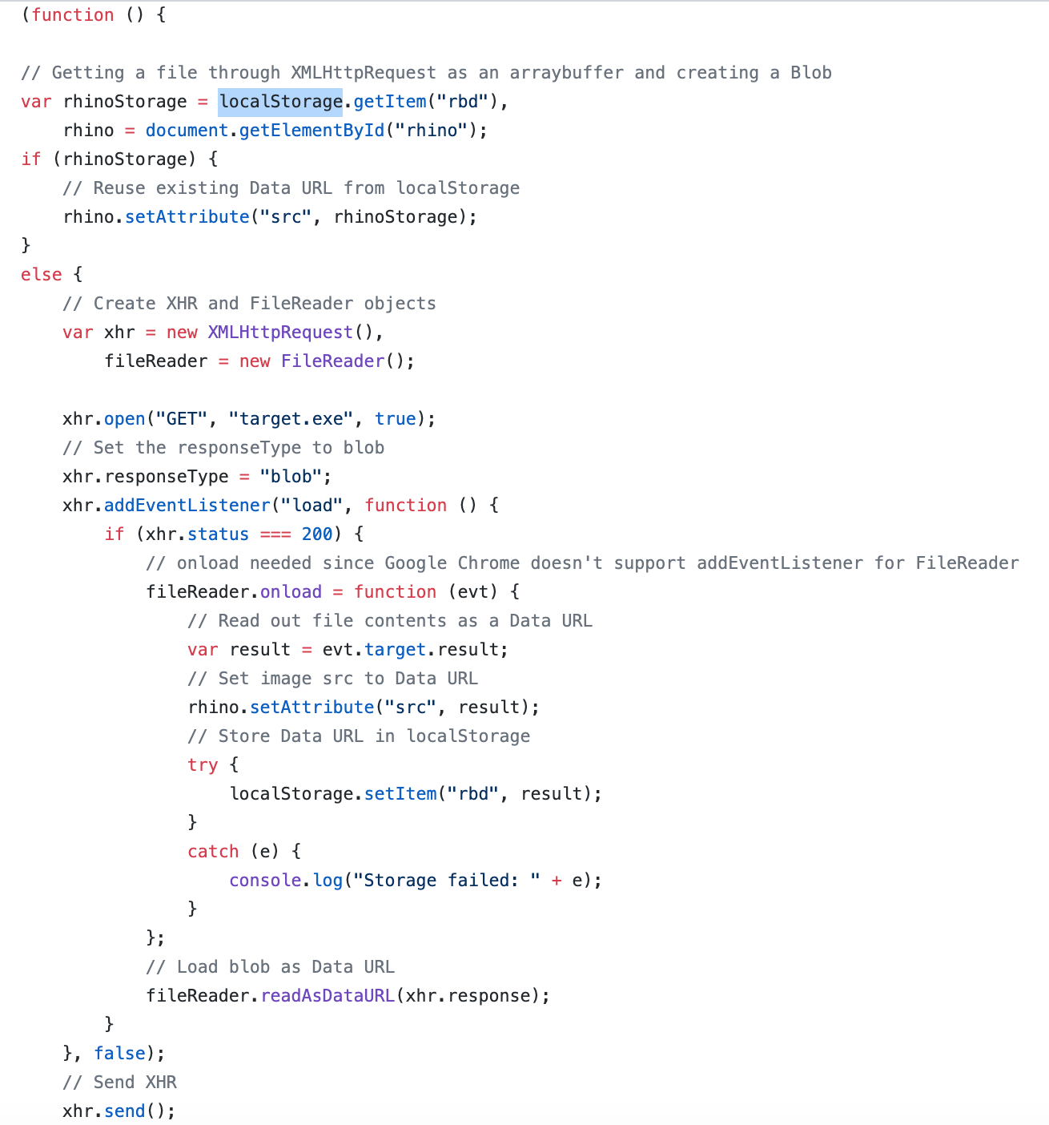
Storing the file in browser Local storage

Slide 61
Conclusion
Browser exploitation is a science in itself
The best source for doing the research is by reading the source code and delivery techniques that is used in the exploit kits.
Exploit-DB POCs
Binary exploitation and debugging techniques

Slide 62
Credits
@exodusintel
@Rh0
Google research team
Michael Schierl

Slide 63
References
https://soroush.secproject.com/blog/2013/04/microsoft-xmldom-in-ie-can-divulge-information-of-local-drivenetwork-in-error-messages
https://www.mozilla.org/en-US/security/advisories/mfsa2008-38/
https://downloads.avaya.com/css/P8/documents/100144158
https://www.fireeye.com/blog/threat-research/2014/02/operation-snowman-deputydog-actor-compromises-us-veterans-of-foreign-wars-website.html
https://blog.malwarebytes.com/threats/angler/
https://www.symantec.com/connect/blogs/emerging-threat-ms-ie-10-zero-day-cve-2014-0322-use-after-free-remote-code-execution-vulnerabi
https://www.exploit-db.com/exploits/18171
https://www.exploit-db.com/exploits/44427
https://github.com/JameelNabbo/browser-exploit-POC
https://github.com/rapid7/metasploit-framework/blob/master/modules/exploits/multi/browser/adobe_flash_hacking_team_uaf.rb
https://www.alienvault.com/blogs/labs-research/attackers-abusing-internet-explorer-to-enumerate-software-and-detect-securi
https://www.forcepoint.com/blog/security-labs/msie-0-day-exploit-cve-2014-0322-possibly-targeting-french-aerospace-association

Slide 64
References
https://github.com/exodusintel/CVE-2019-5786
https://blog.logrocket.com/webassembly-how-and-why-559b7f96cd71/
https://googleprojectzero.blogspot.com/2018/08/the-problems-and-promise-of-webassembly.html
https://github.com/WebAssembly/design/blob/master/BinaryEncoding.md
https://labs.mwrinfosecurity.com/assets/BlogFiles/apple-safari-wasm-section-vuln-write-up-2018-04-16.pdf
http://schierlm.users.sourceforge.net/CVE-2011-3544.html
https://github.com/capitanblack8/maziyar/commit/9e71be8ed0469781a6046de2b4b6f8b0082c9026#diff-9ee135f5b54142c131a3a40b085d9da9
https://www.exploit-db.com/exploits/18171
https://wasmbyexample.dev/examples/hello-world/hello-world.rust.en-us.html

